Slide 1
Spatial Pyramid Pooling in Deep Convolutional Networks for Visual Recognition
arXiv:1406.4729v4 [cs.CV(CVPR)] 23 Apr 2015
Kaiming He, Xiangyu Zhang, Shaoqing Ren, and Jian Sun

Slide 2
OUTLINE
INTRODUCTION
DEEP NETWORKS WITH SPATIAL PYRAMID POOLING
SPP-NET FOR IMAGE CLASSIFICATION
SPP-NET FOR OBJECT DETECTION
CONCLUSION

Slide 3
OUTLINE
INTRODUCTION
DEEP NETWORKS WITH SPATIAL PYRAMID POOLING
SPP-NET FOR IMAGE CLASSIFICATION
SPP-NET FOR OBJECT DETECTION
CONCLUSION

Slide 4
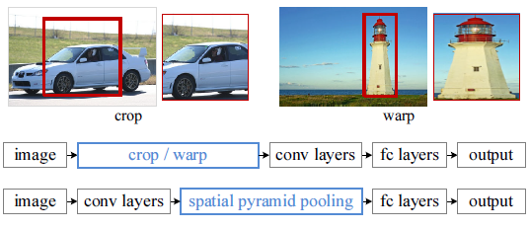
INTRODUCTION
Existing deep convolutional neural networks (CNNs) require a fixed-size (e.g., 224x224) input image
We equip the networks with another pooling strategy “spatial pyramid pooling”, called SPP-net

Slide 5
INTRODUCTION
Pyramid pooling is also robust to object deformations, SPP-net should in general improve all CNN-based image classification methods
The power of SPP-net is also significant in object detection
Using SPP-net, we compute the feature maps from the entire image only once (24x - 102x faster than RCNN)

Slide 6
OUTLINE
INTRODUCTION
DEEP NETWORKS WITH SPATIAL PYRAMID POOLING
SPP-NET FOR IMAGE CLASSIFICATION
SPP-NET FOR OBJECT DETECTION
CONCLUSION

Slide 7
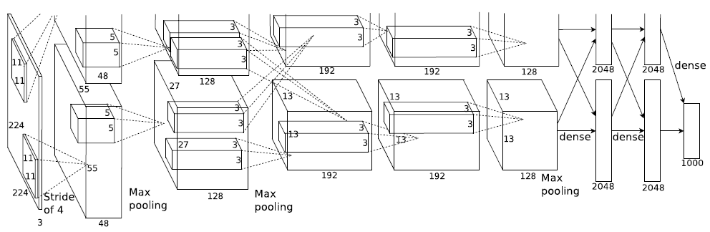
DEEP NETWORKS WITH SPATIAL PYRAMID POOLING
Seven-layer architectures [3](Alex-net), [4](ZF-net)
Five convolutional layers, some of which are followed by pooling layers
Two fully connected layers with an N-way softmax as the output (N is the number of categories)
[3] A. Krizhevsky, I. Sutskever, and G. Hinton, “Imagenet classification with deep convolutional neural networks,” in NIPS, 2012
[4] M. D. Zeiler and R. Fergus, “Visualizing and understanding convolutional neural networks,” arXiv:1311.2901, 2013

Slide 8
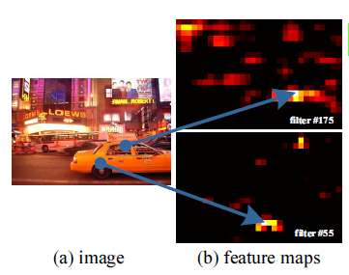
DEEP NETWORKS WITH SPATIAL PYRAMID POOLING
Convolutional layers accept inputs of arbitrary sizes (sliding filters)
Fully-connected layers demand fixed-length vectors as inputs

Slide 9
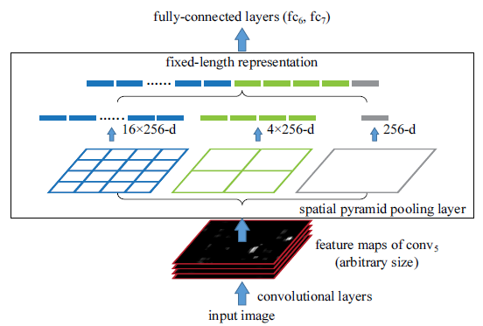

DEEP NETWORKS WITH SPATIAL PYRAMID POOLING
To adopt the deep network for images of arbitrary sizes, we replace the last pooling layer (${pool}_{5}$) with a spatial pyramid pooling layer

Slide 10
DEEP NETWORKS WITH SPATIAL PYRAMID POOLING
This is in contrast to the sliding window pooling of the previous deep networks [3], where the number of sliding windows depends on the input size
We can also resize the input image to any scale (e.g., min(w, h)=180, 224, ...), and the network (with the same filter sizes) will extract features at different scales

Slide 11
DEEP NETWORKS WITH SPATIAL PYRAMID POOLING
Training the Network
Theoretically, the above network structure can be trained regardless of the input image size
But in practice the GPU implementations (such as cuda-convnet [3] and Caffe [35]) are preferably run on fixed input images

Slide 12
DEEP NETWORKS WITH SPATIAL PYRAMID POOLING
Training the Network
Single-size training
Multi-size training

Slide 13
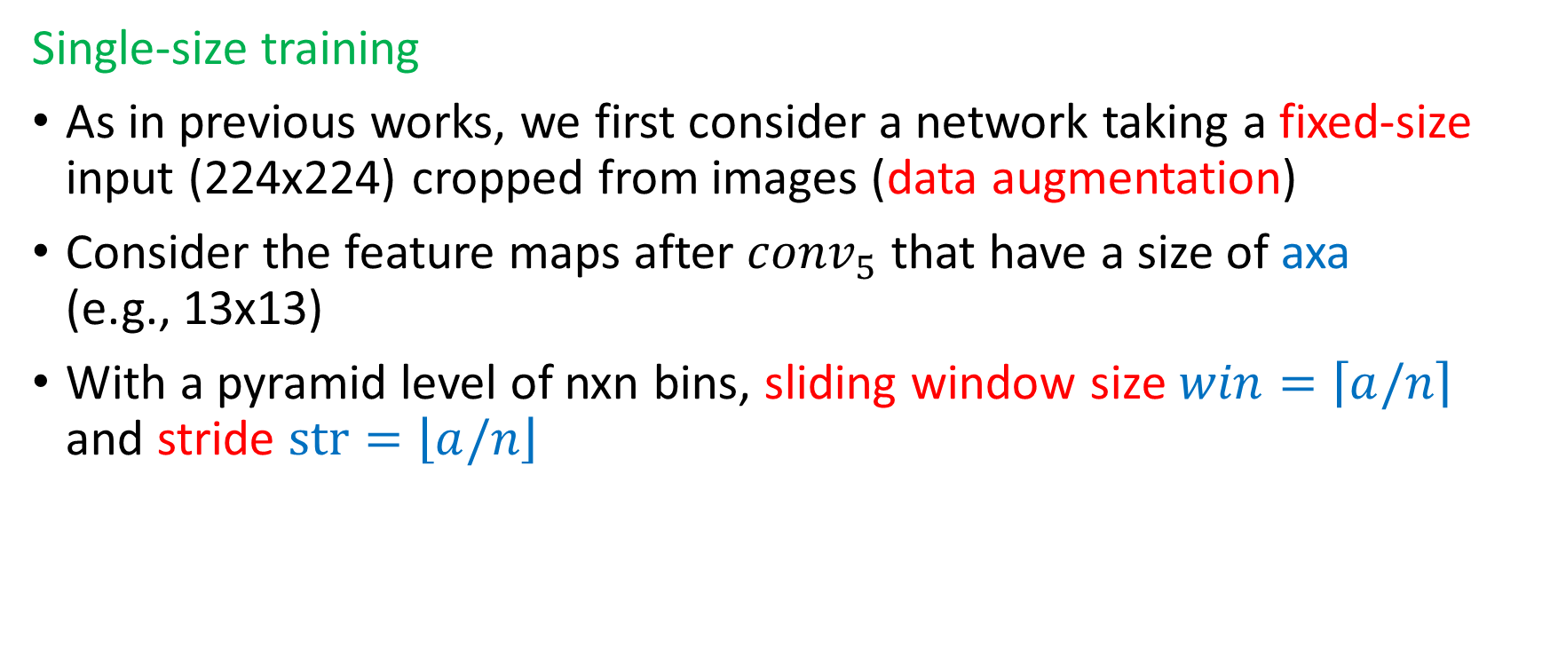
DEEP NETWORKS WITH SPATIAL PYRAMID POOLING
Single-size training
As in previous works, we first consider a network taking a fixed-size input (224x224) cropped from images (data augmentation)
Consider the feature maps after ${conv}_{5}$ that have a size of axa (e.g., 13x13)
With a pyramid level of nxn bins, sliding window size $win=\left\lceil a/n\right\rceil$ and stride $str=\left\lfloor a/n\right\rfloor$

Slide 14
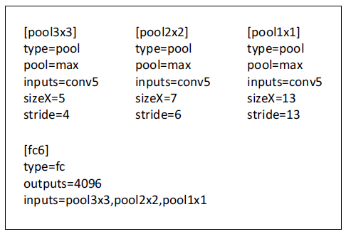
DEEP NETWORKS WITH SPATIAL PYRAMID POOLING

Slide 15
DEEP NETWORKS WITH SPATIAL PYRAMID POOLING
Multi-size training
To address the issue of varying image sizes in training, we consider a set of pre-defined sizes (180x180, 224x224)
Rather than crop a smaller 180x180 region, we resize the 224x224 region to 180x180 (axa=10x10)
180-network has exactly the same parameters as the 224-network in each layer (share parameters)
To reduce the overhead to switch from 224-network to 180, we train each full epoch on one network, and then switch to the other one (keeping all weights) for the next full epoch

Slide 16
DEEP NETWORKS WITH SPATIAL PYRAMID POOLING
We have also tested a variant using sxs as input where s is randomly and uniformly sampled from [180, 224]

Slide 17
OUTLINE
INTRODUCTION
DEEP NETWORKS WITH SPATIAL PYRAMID POOLING
SPP-NET FOR IMAGE CLASSIFICATION
SPP-NET FOR OBJECT DETECTION
CONCLUSION

Slide 18
SPP-NET FOR IMAGE CLASSIFICATION
Experiments on ImageNet 2012 Classification
1000-category training set
All networks in this paper can be trained on a single GeForce GTX Titan GPU (6 GB memory) within two to four weeks

Slide 19
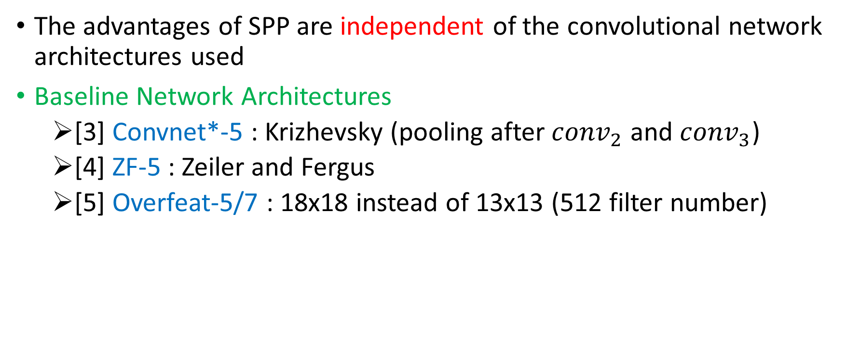
SPP-NET FOR IMAGE CLASSIFICATION
[5] P. Sermanet, D. Eigen, X. Zhang, M. Mathieu, R. Fergus, and Y. LeCun, “Overfeat: Integrated recognition, localization and detection using convolutional networks,” arXiv:1312.6229, 2013
The advantages of SPP are independent of the convolutional network architectures used
Baseline Network Architectures
[3] Convnet*-5 : Krizhevsky (pooling after ${conv}_{2}$ and ${conv}_{3}$)
[4] ZF-5 : Zeiler and Fergus
[5] Overfeat-5/7 : 18x18 instead of 13x13 (512 filter number)

Slide 20
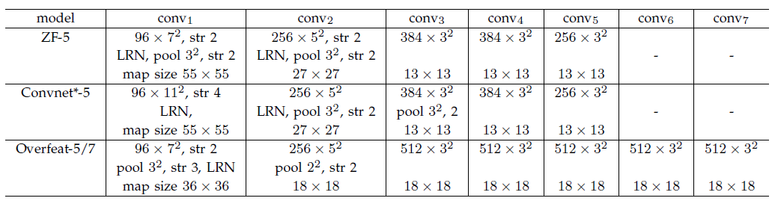
SPP-NET FOR IMAGE CLASSIFICATION

Slide 21
SPP-NET FOR IMAGE CLASSIFICATION
Multi-level Pooling Improves Accuracy
Multi-size Training Improves Accuracy
Full-image Representations Improve Accuracy
Multi-view Testing on Feature Maps

Slide 22
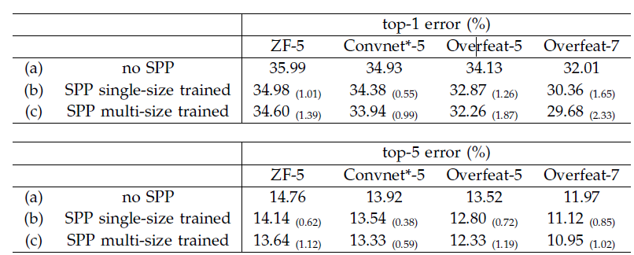
SPP-NET FOR IMAGE CLASSIFICATION
Multi-level Pooling Improves Accuracy
We use a 4-level pyramid {6x6, 3x3, 2x2, 1x1} (totally 50 bins)
For fair comparison, we still use the standard 10-view prediction with each view a 224x224 crop
Error rates in the validation set of ImageNet 2012

Slide 23
SPP-NET FOR IMAGE CLASSIFICATION
It is worth noticing that the gain of multi-level pooling is not simply due to more parameters (50 bins)
We train another ZF-5 network with a different 4-level pyramid {4x4, 3x3, 2x2, 1x1} (totally 30 bins instead of 36)
The top-1/top-5 errors of this network are 35.06/14.04 (35.99/14.76)

Slide 24
SPP-NET FOR IMAGE CLASSIFICATION
Multi-size Training Improves Accuracy
The training sizes are 224 and 180, while the testing size is still 224
We still use the standard 10-view prediction

Slide 25
SPP-NET FOR IMAGE CLASSIFICATION
We have also evaluated using a random size uniformly sampled from [180, 224] (Overfeat-7: 30.06%/10.96%)
Possibly because the size of 224 (which is used for testing) is visited less

Slide 26
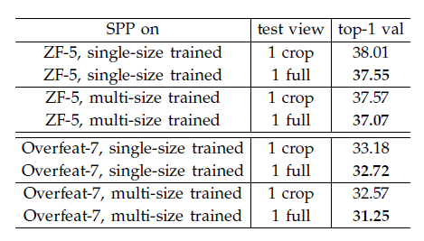
SPP-NET FOR IMAGE CLASSIFICATION
Full-image Representations Improve Accuracy
We resize the image so that min(w, h)=256 while maintaining its aspect ratio
For fair comparison, we also evaluate the accuracy of the single view in the center 224x224 crop
Error rates in the validation set of ImageNet 2012 using a single view

Slide 27
SPP-NET FOR IMAGE CLASSIFICATION
We find that the combination of multiple views is substantially better than the single full-image view
We empirically find that even for the combination of dozens of views, the additional two full-image views (with flipping) can still boost the accuracy by about 0.2%

Slide 28
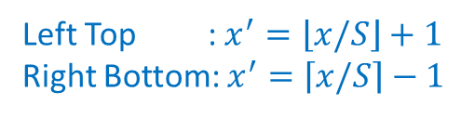
SPP-NET FOR IMAGE CLASSIFICATION
Left Top : $x^{′}=\left\lfloor x/S\right\rfloor +1$
Right Bottom: $x^{′}=\left\lceil x/S\right\rceil −1$
Multi-view Testing on Feature Maps
Resize an image so min(w, h) = s where s represents a predefined scale (like 256)
Compute the convolutional feature maps from the entire image (and flipped image)
Given any view in the image, we map this window to the feature maps
Use SPP to pool the features from this window

Slide 29
SPP-NET FOR IMAGE CLASSIFICATION
Fed into the fc layers to compute the softmax score of this window
These scores are averaged for the final prediction

Slide 30
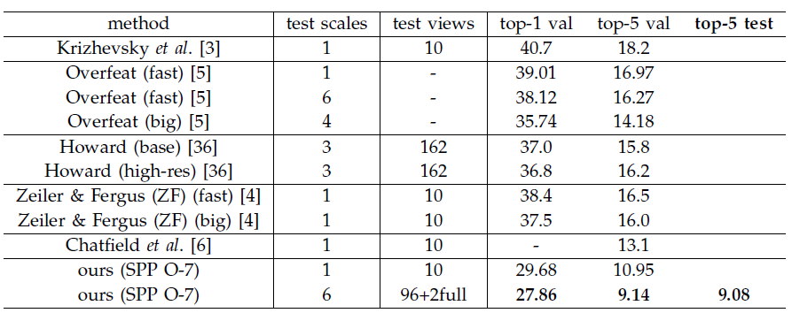
SPP-NET FOR IMAGE CLASSIFICATION
Error rates in ImageNet 2012
s=256
s={224, 256, 300, 360, 448, 560}
9.36
(no flipping)
6 views+18 views*5=96
(224) (others)
= (4+4+1)*2

Slide 31
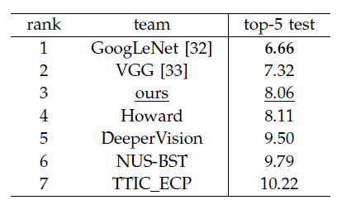
SPP-NET FOR IMAGE CLASSIFICATION
ILSVRC 2014 classification
Single model : 9.08%
Eleven models : 8.06%

Slide 32
SPP-NET FOR IMAGE CLASSIFICATION
Experiments on VOC 2007 Classification
Involves 9,963 images in 20 categories
5,011 images are for training, and the rest are for testing
The performance is evaluated by mean Average Precision (mAP)

Slide 33
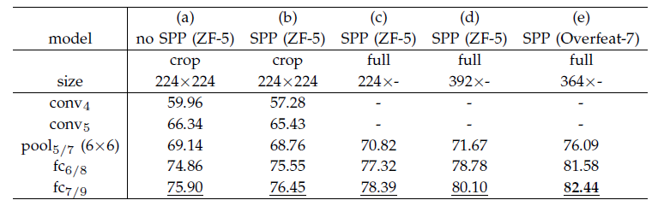
SPP-NET FOR IMAGE CLASSIFICATION
Networks pre-trained on ImageNet
Re-train SVM classifiers (1000->20)
Intentionally do not use any data augmentation (flip/multi-view)
best model
objects occupy smaller regions in VOC 2007 but larger regions in ImageNet

Slide 34
SPP-NET FOR IMAGE CLASSIFICATION
[21] L. Fei-Fei, R. Fergus, and P. Perona, “Learning generative visual models from few training examples: An incremental bayesian approach tested on 101 object categories,” CVIU, 2007
Experiments on Caltech101
The Caltech101 dataset [21] contains 9,144 images in 102 categories (one background)
We randomly sample 30 images per category for training and up to 50 images per category for testing
We repeat 10 random splits and average the accuracy

Slide 35
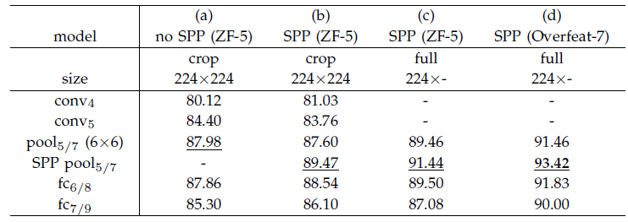
SPP-NET FOR IMAGE CLASSIFICATION
warping 89.91%
the object categories in Caltech101 are less related to those in ImageNet

Slide 36
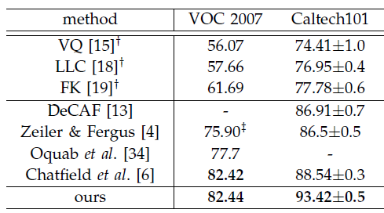
SPP-NET FOR IMAGE CLASSIFICATION

Slide 37
OUTLINE
INTRODUCTION
DEEP NETWORKS WITH SPATIAL PYRAMID POOLING
SPP-NET FOR IMAGE CLASSIFICATION
SPP-NET FOR OBJECT DETECTION
CONCLUSION

Slide 38
SPP-NET FOR OBJECT DETECTION
R-CNN :
Extracts about 2,000 candidate windows from each image via selective search
Warped to a fixed size (227x227)
A pre-trained deep network is used to extract the feature
A binary SVM classifier is then trained on these features for detection
However, R-CNN repeatedly applies the deep convolutional network to about 2,000 windows per image (time-consuming)

Slide 39
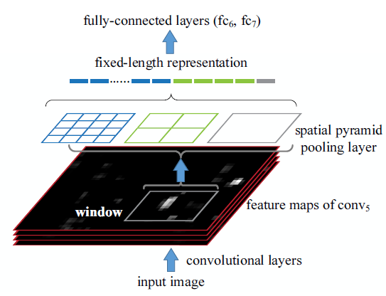
SPP-NET FOR OBJECT DETECTION
Our SPP-net can feature maps from the entire image only once
Our method extracts window-wise features from regions of the feature maps, while R-CNN extracts directly from image regions

Slide 40
SPP-NET FOR OBJECT DETECTION
We use the “fast” mode of selective search [20] to generate about 2,000 candidate windows per image
Resize the image such that min(w, h) = s (s=688), and extract the feature maps from the entire image
Use the SPP-net model of ZF-5 (single-size trained)
4-level spatial pyramid (1x1, 2x2, 3x3, 6x6, totally 50 bins) to pool the features
These representations (256x50-d) are provided to the fully-connected layers of the network
Train a binary linear SVM classifier for each category on these features

Slide 41
SPP-NET FOR OBJECT DETECTION
In testing, the classifier is used to score the candidate windows
Then we use non-maximum suppression (threshold of 30%) on the scored windows

Slide 42
SPP-NET FOR OBJECT DETECTION
Our method can be improved by multi-scale feature extraction min(w, h) = s = {480, 576, 688, 864, 1200}
One strategy of combining the features from these scales is to pool them channel-by-channel
The better strategy is choosing a single scale s such that the scaled candidate window has a number of pixels closest to 224x224
Then we only use the feature maps extracted from this scale to compute the feature of this window

Slide 43
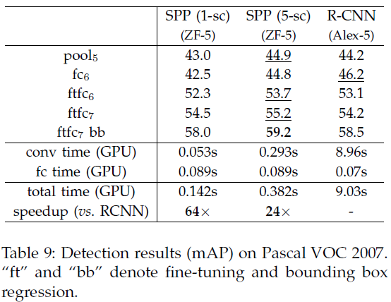
SPP-NET FOR OBJECT DETECTION
fc layers are pre-trained using image regions, while in the detection case they are used on the feature map regions. The feature map regions can have strong activations near the window boundaries, while the image regions may not

Slide 44
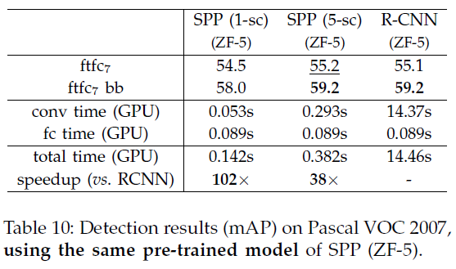
SPP-NET FOR OBJECT DETECTION
Better architecture of ZF-5 than AlexNet, and also because of the multi-level pooling of SPPnet

Slide 45
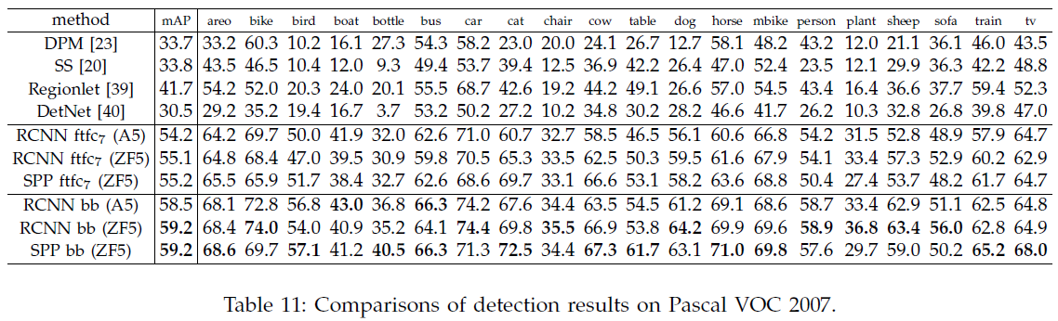
SPP-NET FOR OBJECT DETECTION

Slide 46
SPP-NET FOR OBJECT DETECTION
Model Combination for Detection
Model combination is an important strategy for boosting CNN-based classification accuracy
We pre-train another network in ImageNet, using the same structure but different random initializations
Then repeat the above detection algorithm

Slide 47
SPP-NET FOR OBJECT DETECTION
We first use either model to score all candidate windows on the test image
Perform non-maximum suppression on the union of the two sets of candidate windows (with their scores)

Slide 48
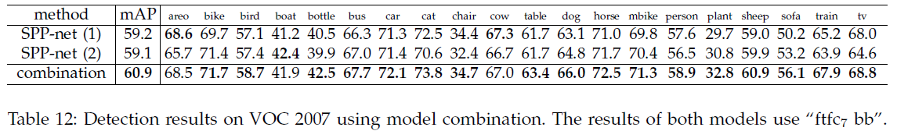
SPP-NET FOR OBJECT DETECTION

Slide 49
SPP-NET FOR OBJECT DETECTION
ILSVRC 2014 Detection
200 categories
450k/20k/40k images in the training/validation/testing sets (1000-category CLS training data is not allowed to use)
There are three major differences between the detection (DET) and classification (CLS) training datasets

Slide 50
SPP-NET FOR OBJECT DETECTION
The DET training data is merely 1/3 of the CLS training data
The category number of DET is 1/5 of CLS
Pre-train a 499-non-overlapping subcategories network
The distributions of object scales are different between DET/CLS training sets (0.5/0.8)
Resize each training image to min(w, h) = 400 (instead of 256), and randomly crop 224x224 views for training
overlap ground truth at least 50%

Slide 51
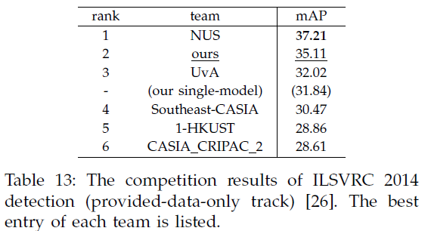
SPP-NET FOR OBJECT DETECTION
6 models

Slide 52
OUTLINE
INTRODUCTION
DEEP NETWORKS WITH SPATIAL PYRAMID POOLING
SPP-NET FOR IMAGE CLASSIFICATION
SPP-NET FOR OBJECT DETECTION
CONCLUSION

Slide 53
CONCLUSION
SPP is a flexible solution for handling different scales, sizes, and aspect ratios
The resulting SPP-net shows outstanding accuracy in classification/detection tasks
Greatly accelerates DNN-based detection

Slide 54
Thanks for listening!

